Slide 1
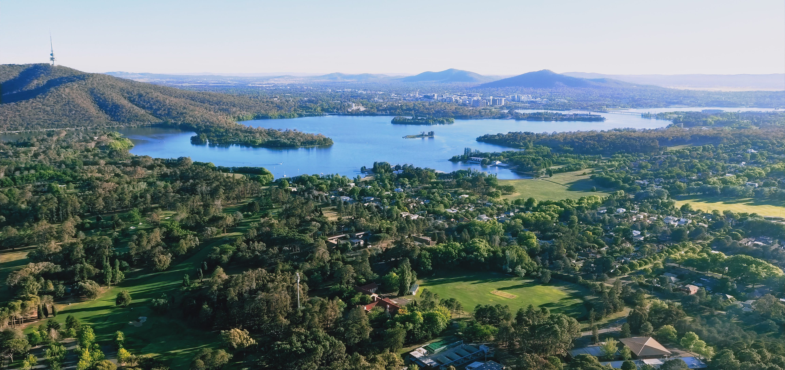

Capturing covid19 data for the ACT
Journal submission and supporting documentation
A R Davidson

Slide 2

Data
Analysis/
Visualisation
Communicate

Slide 3
Outline
General background
Application to covid19
Greater implications and applications

Slide 4
contact locations
Overall map
Timeline of cases in Suburbs
Information on Transit routes and contact locations

Slide 5
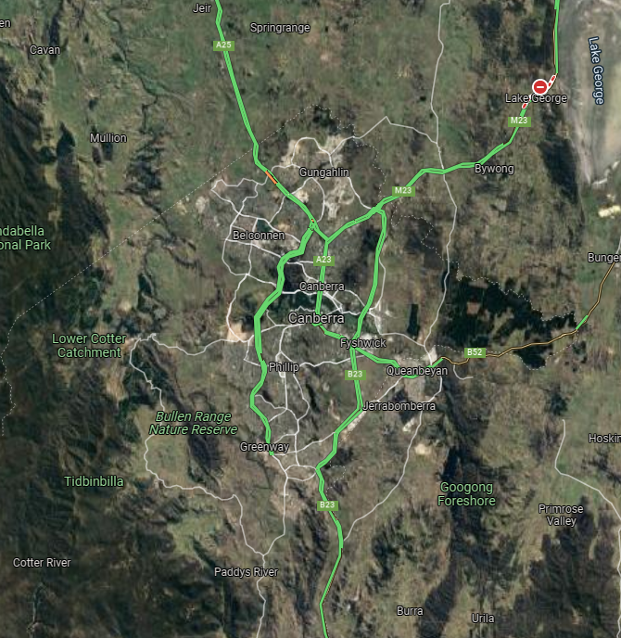
Information
GOVT data including map and table of contact locations and times
Visualizations already available for case and vaccine numbers
This is a local tool for local Canberrans
Focuses on current and dynamic data

Slide 6
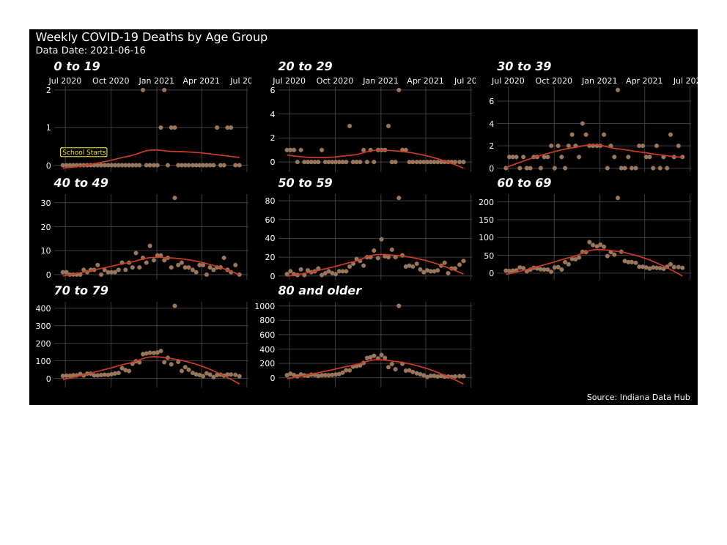
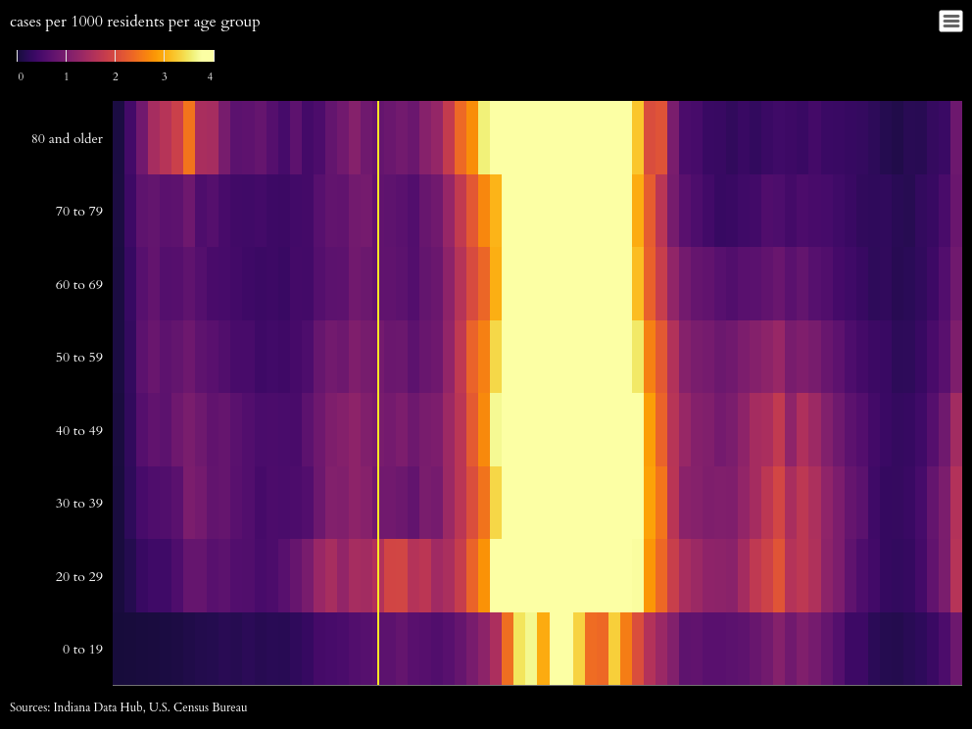
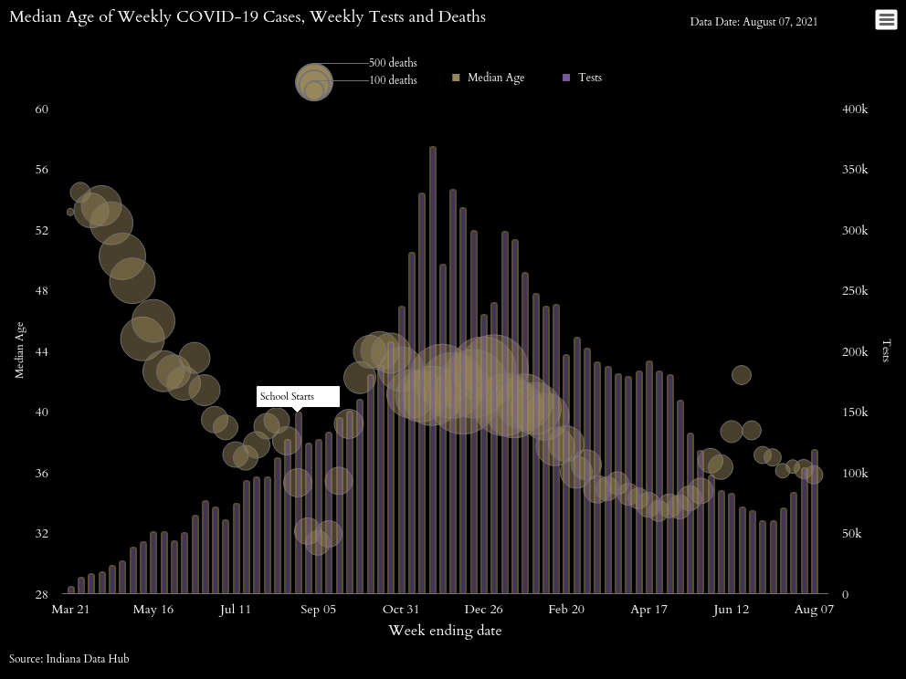
Lots of examples (github.com/act-covid-resources/)
Curated open science resources can be found in github repository
Many others I missed last year so added them here

Slide 7
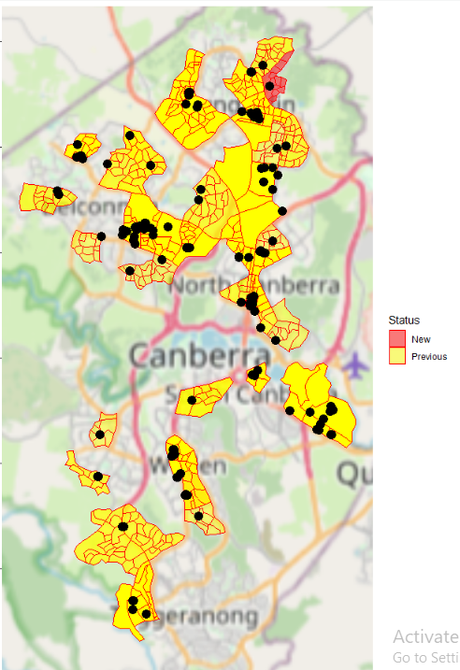
Why another map?
Simple
Geolocations were confusing
Information was just a html table to begin with
Other location reasons can include:
ACT is small and info comes from NSW and ACT goverments (STATE) as well as FEDERAL
Even weird rules were no one knows what is going on?? (example?)

Slide 8
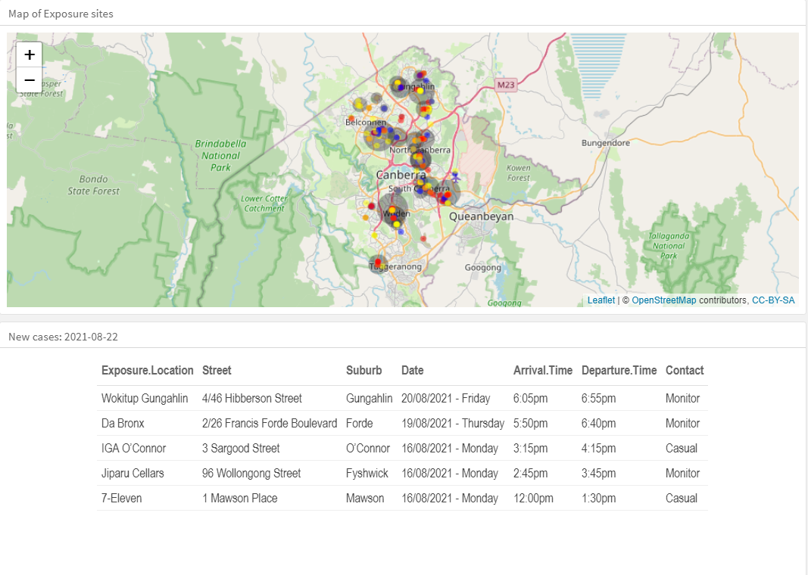
Turns out it helps to have it simple

Slide 9
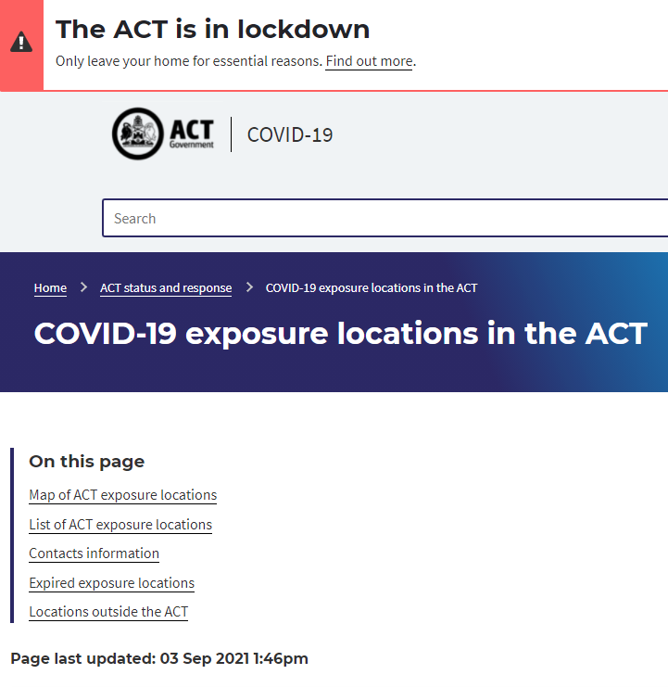
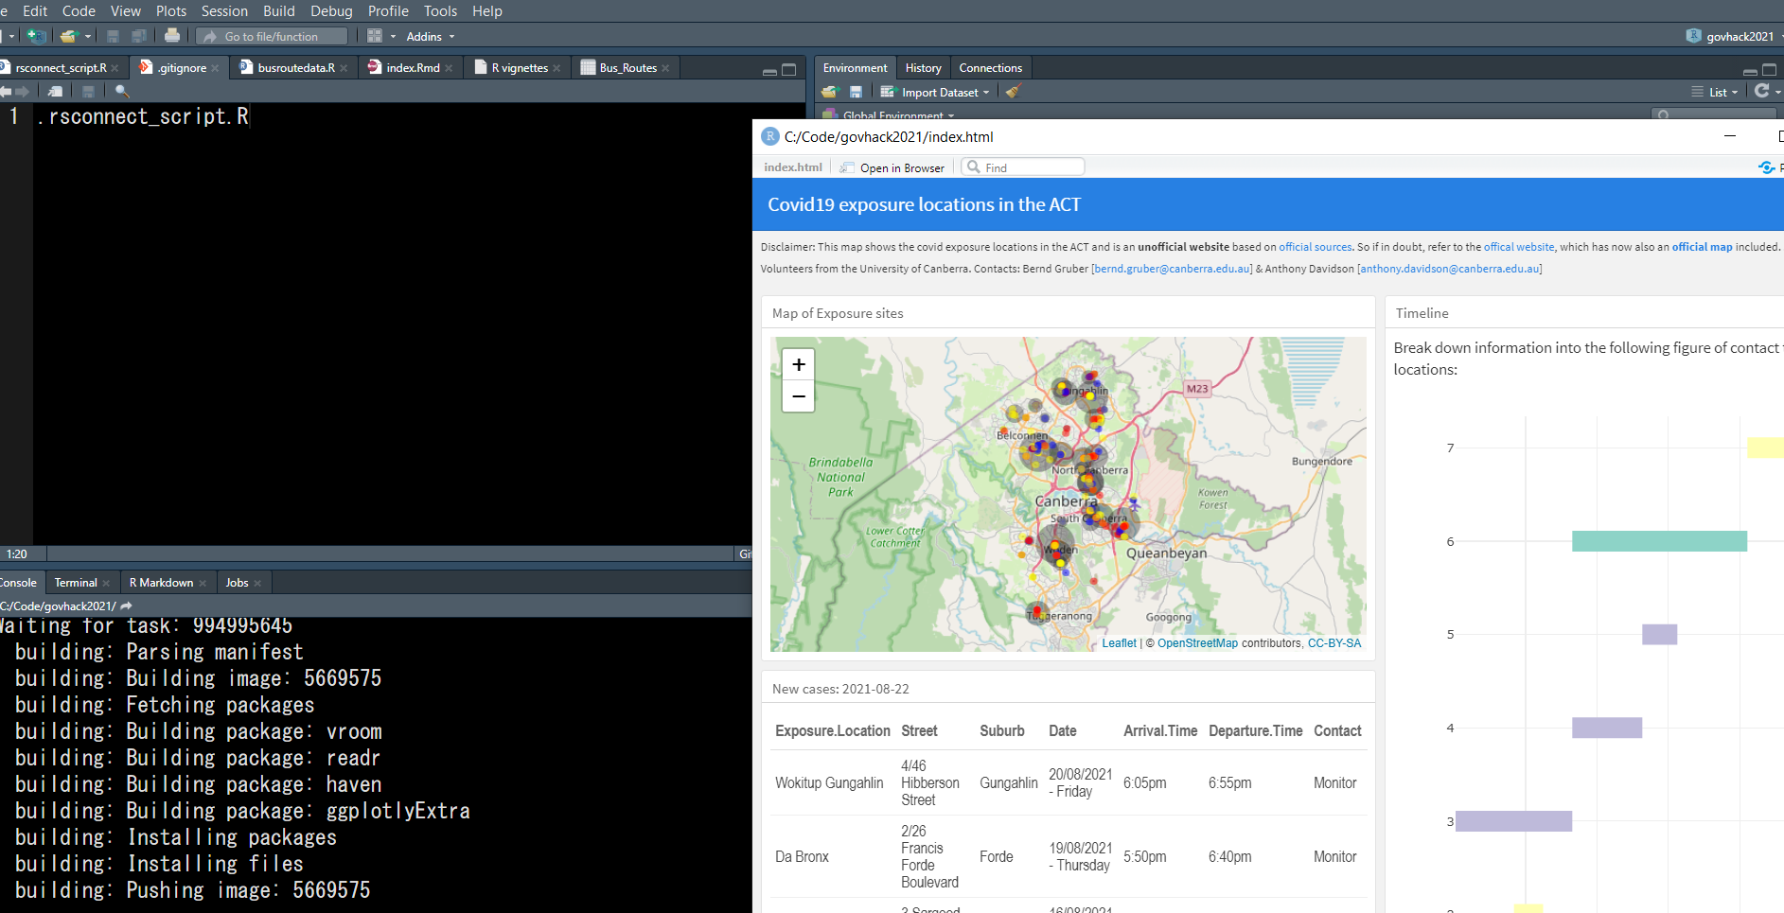
Workflow
Data
Download webpage
Compare to last.file
if new webpage update
Add these to last.csv with new tag
Check these tags
Analysis/
Visualisation
Communicate

Slide 10
Workflow
Download webpage
Compare to last.file
if new webpage update
Add these to last.csv with new tag
Check these tags
Data
Analysis/
Visualisation
Communicate

Slide 11
And there are examples thanks to the open source world
Plot curated list of contact locations with update time associated with latest fixed co-ordinates?
Have to think about every update as a observation in time in the same manner that a fossil changes as information becomes available

Slide 12
Map
and
timeline
?
Analysis/Visualisation
Data
Communicate

Slide 13
Map
and
timeline
Analysis/Visualisation
Data
Communicate

Slide 14
Map
and
timeline
?
Analysis/Visualisation
Data
Communicate

Slide 15
Rstudio and R!?!
Wrangling
Data
Map
and
timeline
Communicate
Analysis/Visualisation

Slide 16
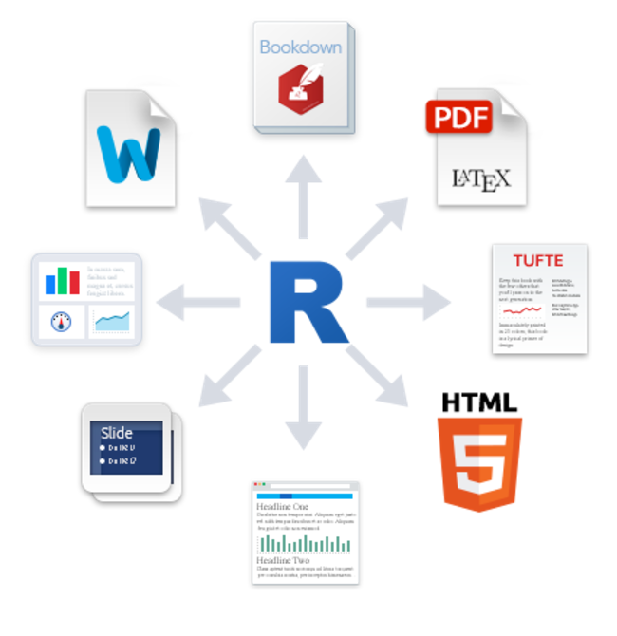
Tools
Open source
R
Rstudio
Github
Github-pages
Flexdashboard

Slide 17
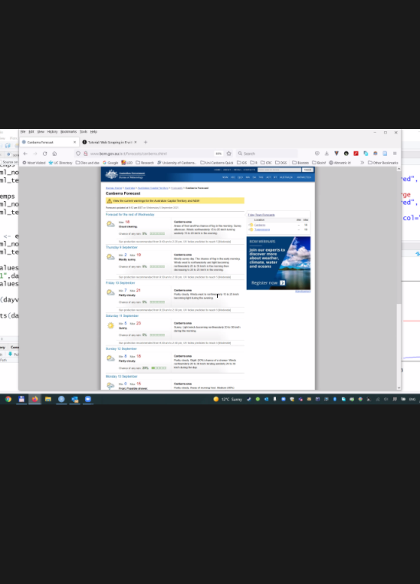
Rcafe this week
DATA
Based on groups:
Fgovt
Sgovt
Uni
GlobalOrg
Social
Wordofmouth (wom)

Slide 18
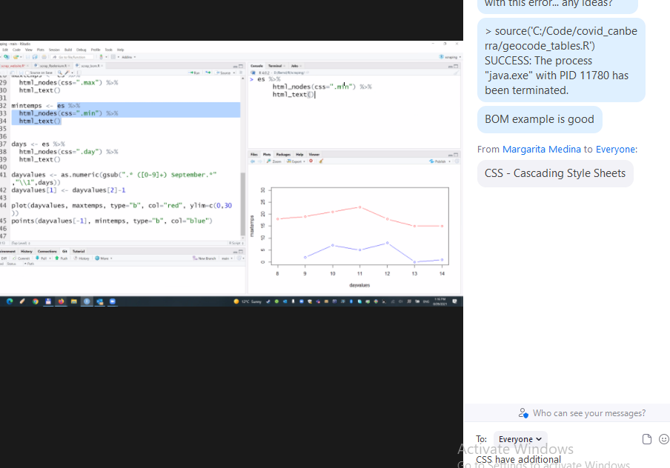
Spatial Math
Projections and transformations (crs)
Geo-coding to find locations. This scale matters

Slide 19
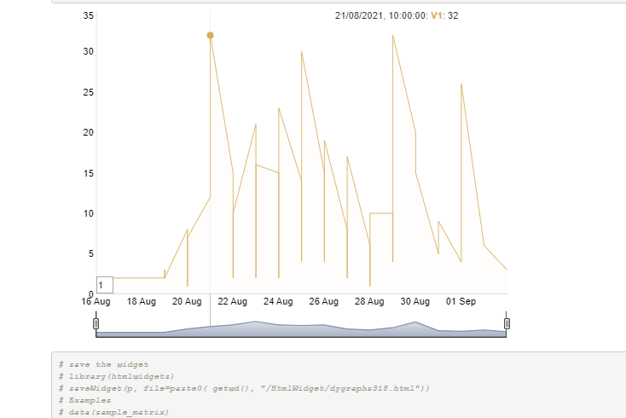
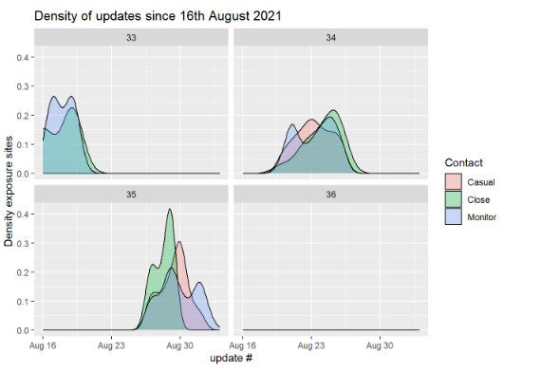
Timeline of duration (grouped areas)
The way we group time matters….
By month, date or fixed group makes big differences in the STRENGTH of inference that can be made but this does not account for detection issues

Slide 20
Scale matters? Why?
Projections and transformations (crs)
Geo-coding to find locations. This scale matters

Slide 21
GOVT data including map and table of contact locations and times
Visualizations already available for case and vaccine numbers
This is a local tool for local Canberrans
Focuses on current and dynamic data
GOVT data including map and table of contact locations and times
Visualizations already available for case and vaccine numbers
This is a local tool for local Canberrans
Focuses on current and dynamic data

Slide 22
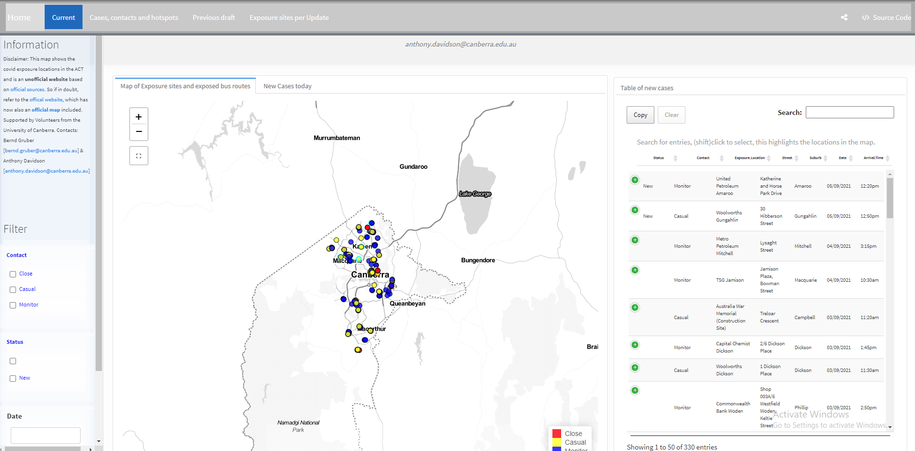
Final Dashboard

Slide 23
Extentions
CRISPER anu data
Govt info they need and want it

Slide 24
Discussion
Engagement with ACT health
Power BI dashboard
Integrate of either csv or tools
Need support to curate data and publish….

Slide 25
Turns out not that easy
Best to write function as an vector applied to a matrix
Allows for storing both location and time information of varying lengths
Call this using a set of functions
Or just work from the full dataset
Here this is called last.csv

Slide 26
Capturing covid19 data for the ACT
Questions?
A R Davidson

Slide 27
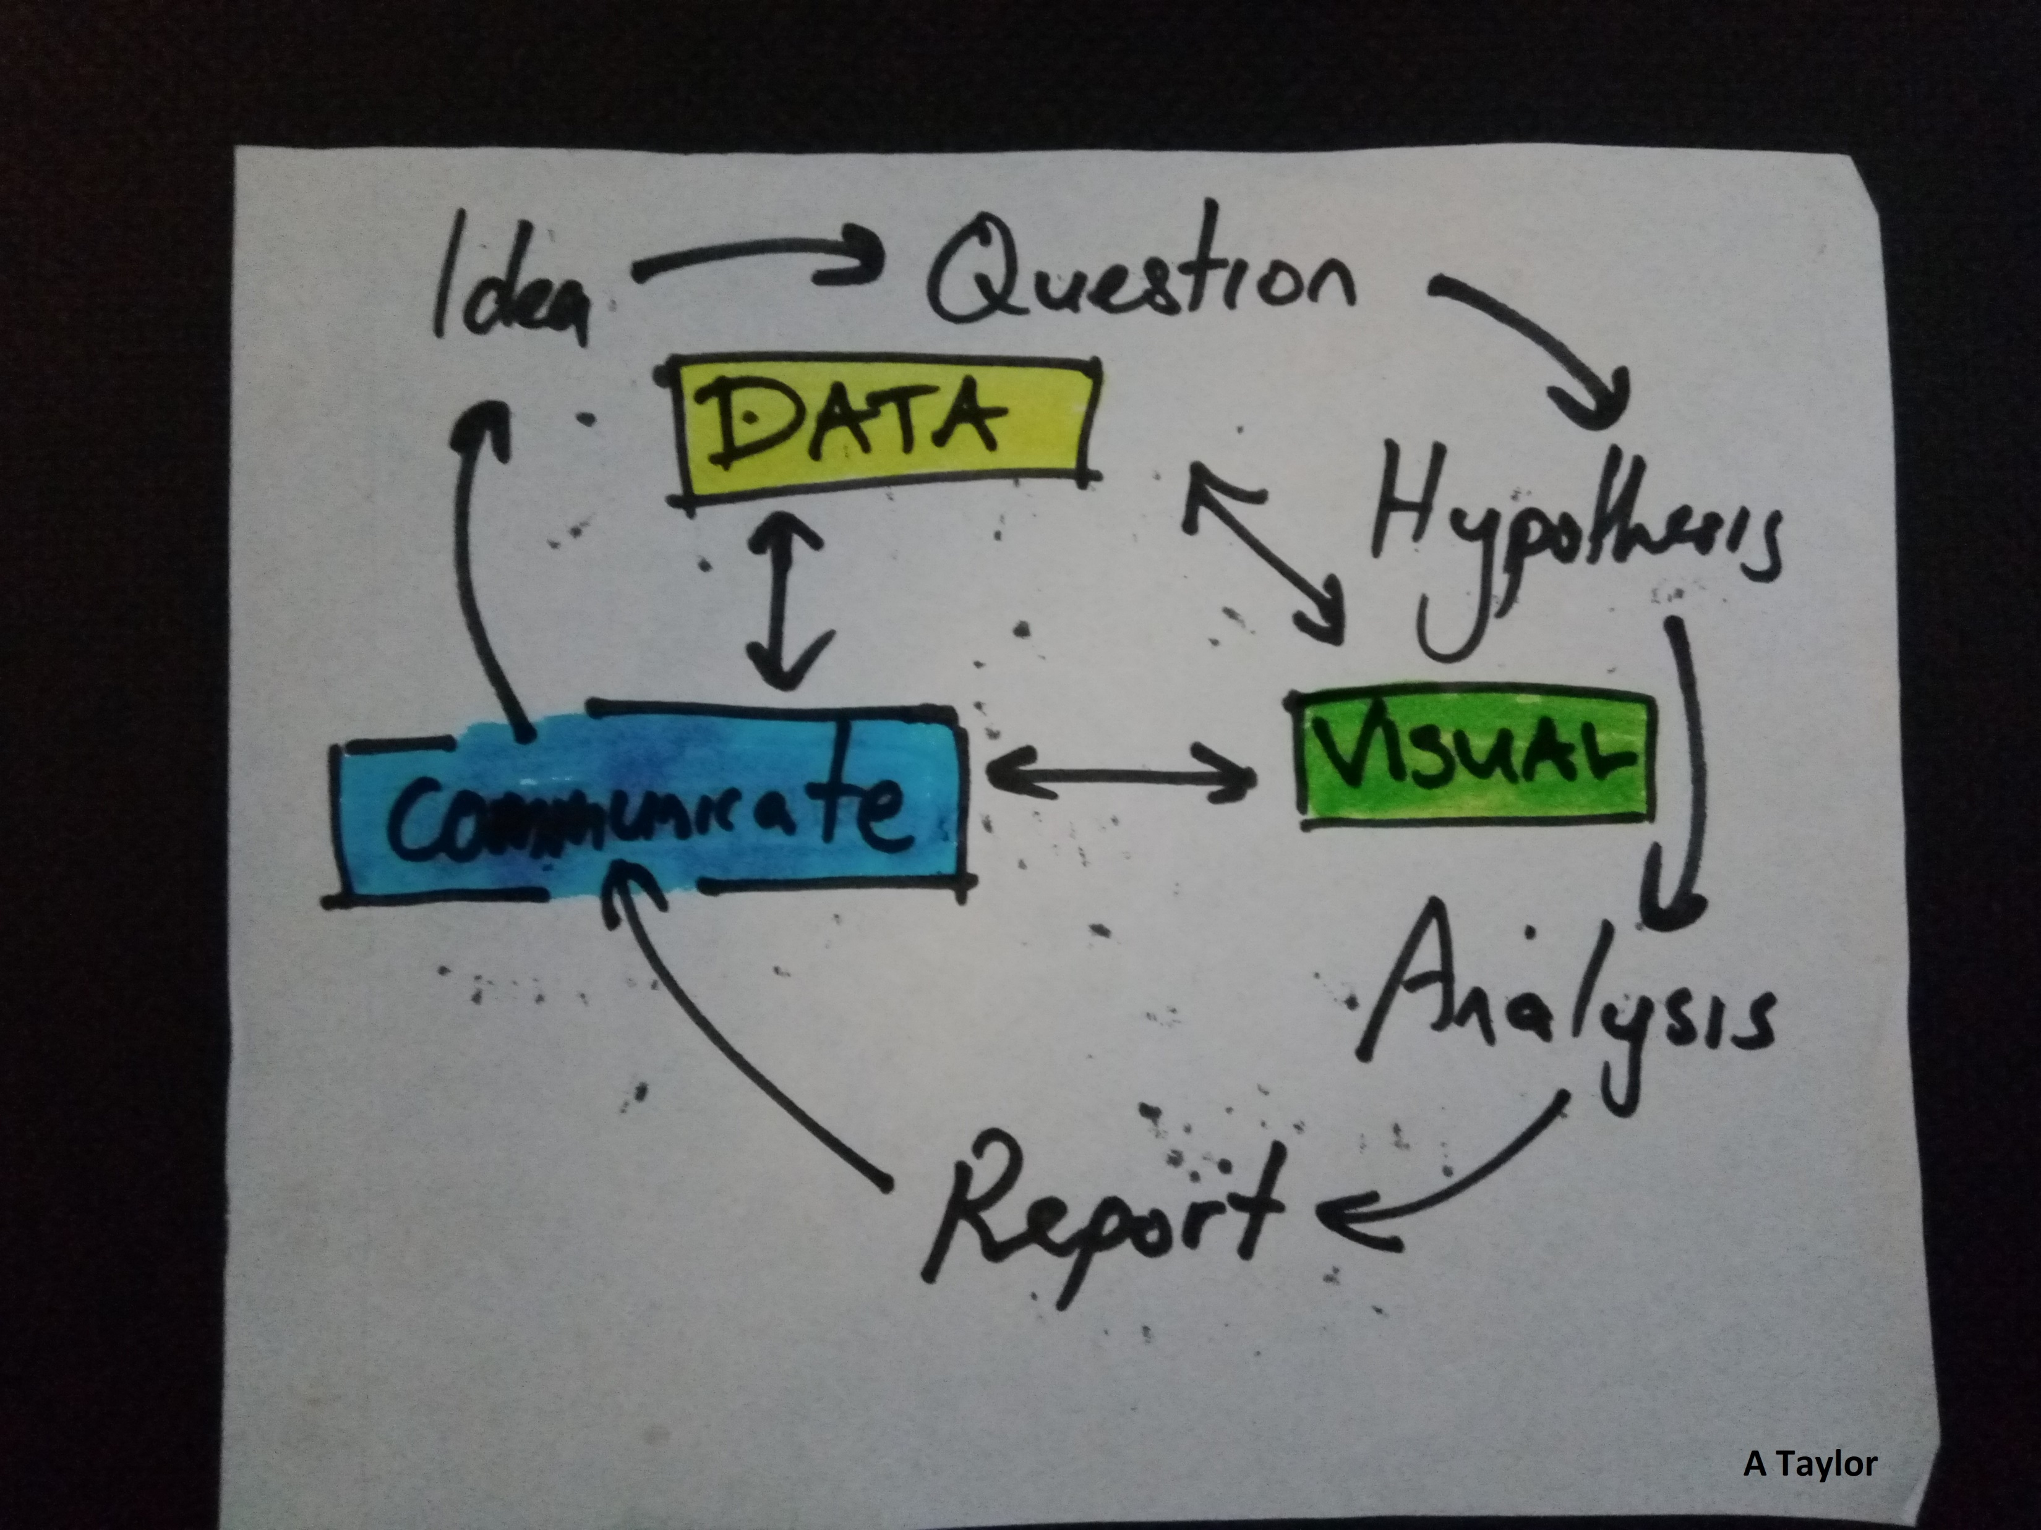
All adds up to scientific workflow

Slide 28


Slide 29

Data
Function[Tags[CCS]t}]
$$∞$$
CHAIN RULE
Function[function[x]] = ……
Ci
Ci

Slide 30

$$∞$$
Function[Tags[CCS]t}]
Data
CHAIN RULE
Function[function[x]] = ……

Slide 31
Data
Analysis/
Visualisation
Communicate

Slide 32
Simple workflow
Data
Analysis/
Visualisation
Communicate

Slide 33
See current work on tidypipes for details
Standard formats
Location
Time
If not before here…from here: 16th August 2021

Slide 34
Different observations of these states?
Found it easiest to think of time and space as additional information for now
TABLE nope…
LIST()
- Day of week
- Start and end times
- Exact date
- Day since outbreak
- Update number
Timeline
TIME
Start and end times
Exposure date

Slide 35
Different observations of these states?
TABLE nope…
LIST()
Found it easiest to think of time and space as additional information for now
Start and end times
Exposure date
Function will:
Sort time to 24hrs []()
TIME
- Day of week
- Start and end times
- Exact date
- Day since outbreak
- Update number

Slide 36
Timeline

Slide 37
oUTPUT
DATA
DATA:actwebsite: csv table…..
iNVESTIGATE
Different visualization options
- IN R: leaflet
Plotly
Knitr
Png
Jpeg
etc
TABLE nope…
LIST()
Timeline
SPACE
TIME
Map

Slide 38

How
DATA
Table (wrangling timedate_etc)
csv
Download webpage
Check date/update
Diff to lastupdate.csv
Base map
Compare to last.file
if new webpage update
Add these to last.csv with new tag
Check these tags
Plot curated list with update time associated with latest fixed co-ordinates?

Slide 39
aSPECTS
Engagement with ACT health
Power BI dashboard
Integrate of either csv or tools
Need support to curate data and publish….

Slide 40
Final result is
Flexdash
Our selection of dynamic components for gh-pages publishing == boring rmds
Tidy data and a tidy approach
Dynamic time update info:
Site build
Bernds site
ACT health

Slide 41
Map all cases
Filter by Status, Contact, and Suburb
Colour represents Contact
Shape represents New, previously added
Date coming??
Dynamic time update info:
Site build
Bernds site
ACT health

Slide 42
Map grouped areas
Group by
Suburb,
Contact
Status
Update_time -→ location and timing changes….
Output is Census level grouping SA3
This can be changed to SA2, SA1 or other generalisations such as post codes
Development involves including a emailed report fitted to the Suburb grouping variable
[different email = = different group selected]

